Slide 1
Real Estate Data Pipeline for Market Analysis
ANIL KUMAR JAT

Slide 2
INDEX
Data pipeline flowchart.
Understand Data.
Mysql commands for integrating data
Sqoop commands importing data from MYSQL to HDFS and Hive
Hive commands and query
Data in HDFS
Spark –Airflow
Additionally Run PySpark Job With help of PySpark Script
Load Data in Hive
Check Data Quality And Analysis With Hive Query
Visualization By Power Bi and ML

Slide 3










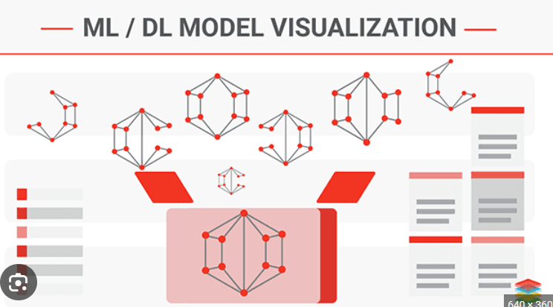
Data pipeline flowchart.
Hive query

Slide 4
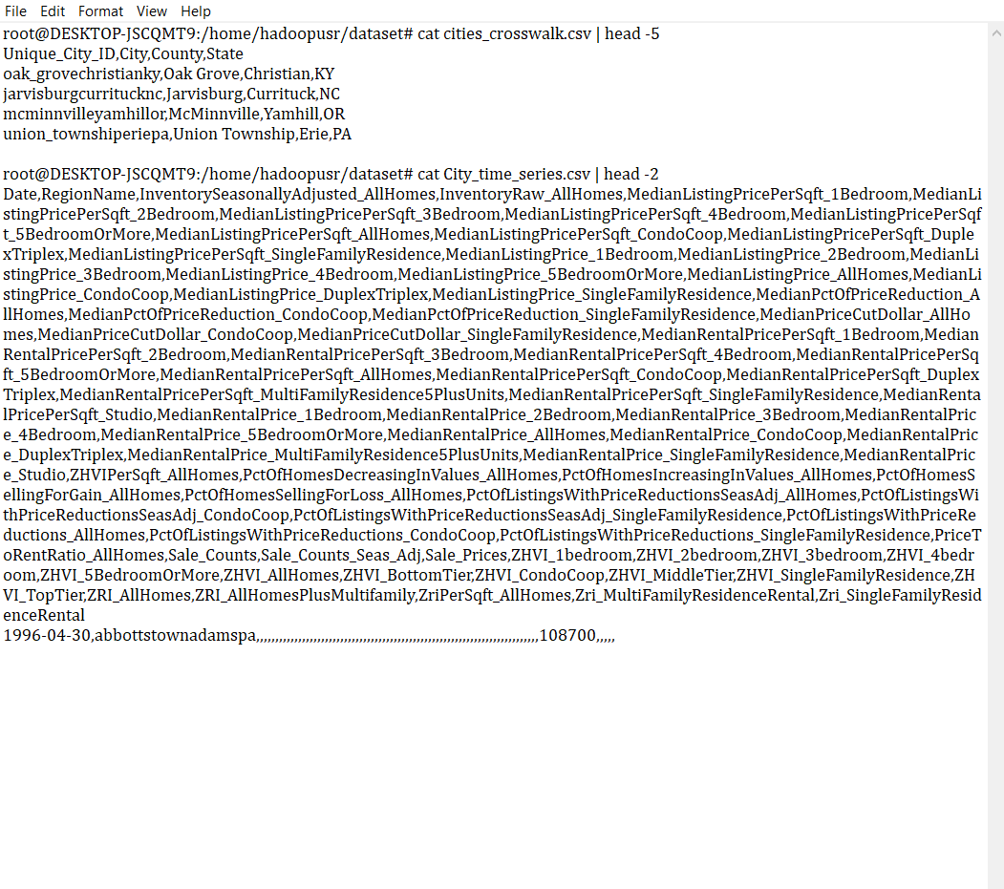
Understand Data

Slide 5
What is ZHVI And ZRI
ZHVI_AllHomes :ZHVI_AllHomes is a metric provided by Zillow that estimates the median market value of homes across various types, including single-family homes, condominiums, and cooperative housing units within a specific geographic area. ZHVI_AllHomes is a widely referenced indicator for understanding the overall real estate market trends and property values at a macro level.e In
ZRI_AllHomes :ZRI_AllHomes is a metric provided by Zillow that estimates the median monthly rent for both single-family homes and apartments within a specific geographic area. Similar to the Zillow Home Value Index (ZHVI), which estimates property values, ZRI_AllHomes provides insights into rental market trends.

Slide 6
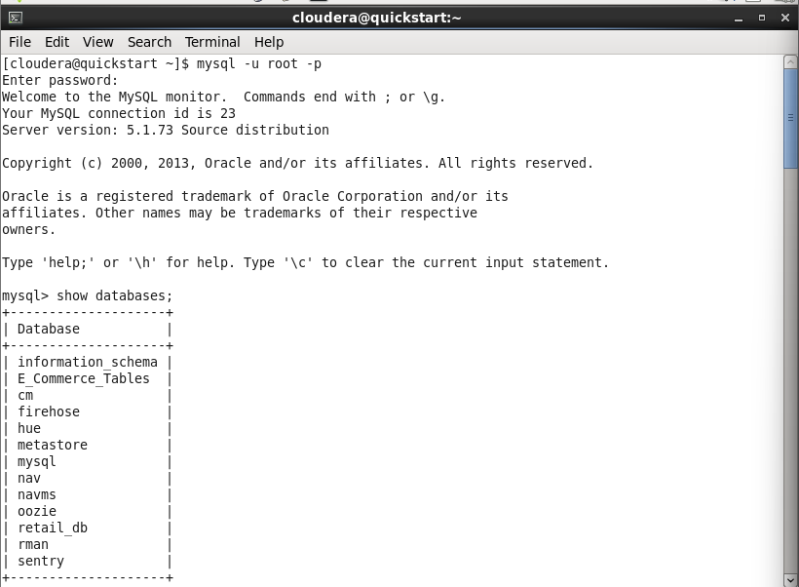
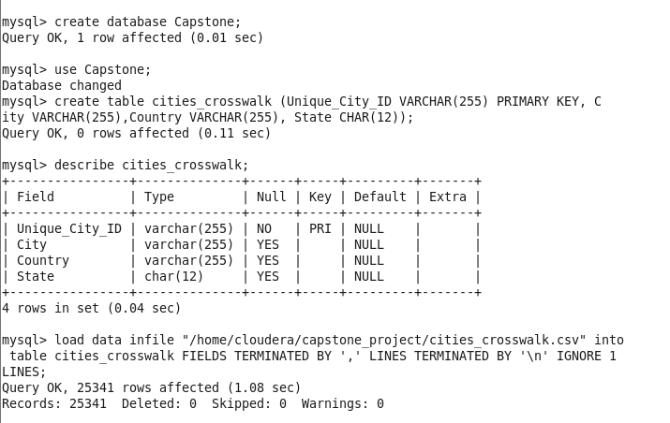
Mysql commands for Create Databases and Table

Slide 7
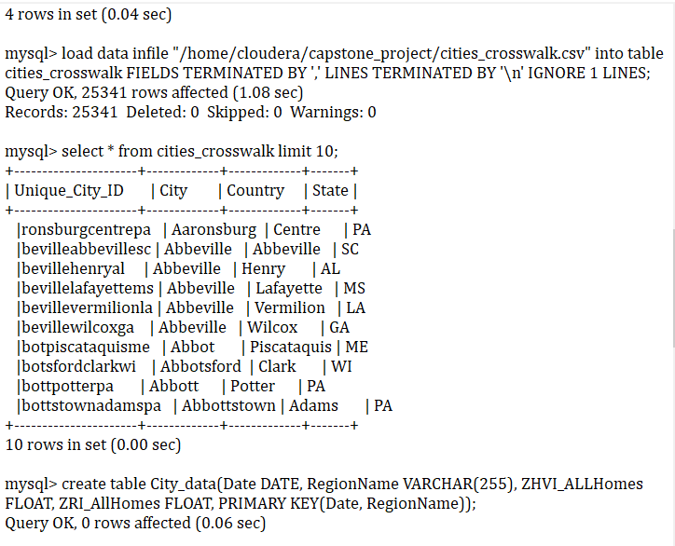
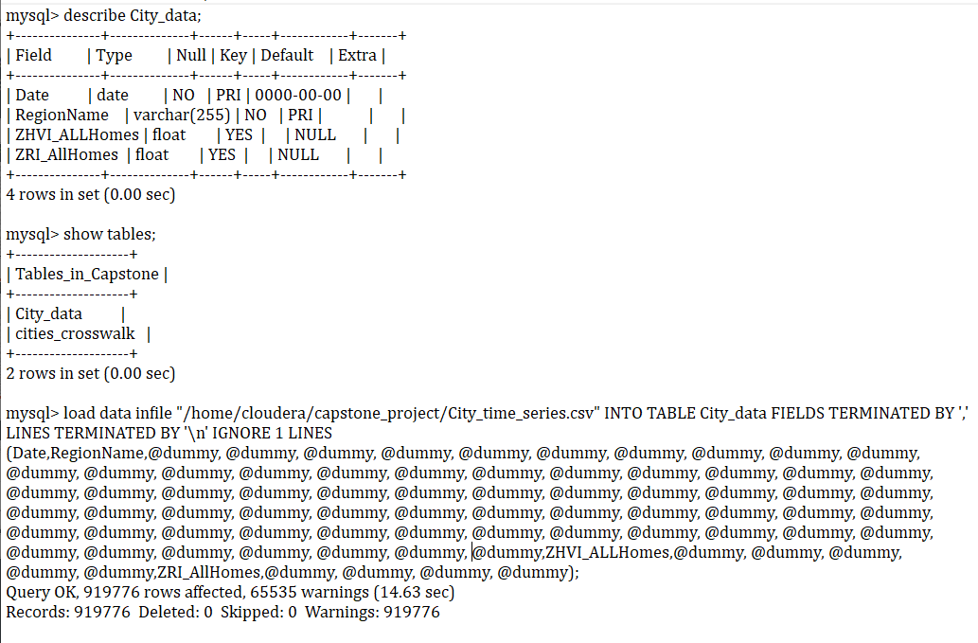
Mysql commands for Create Table

Slide 8
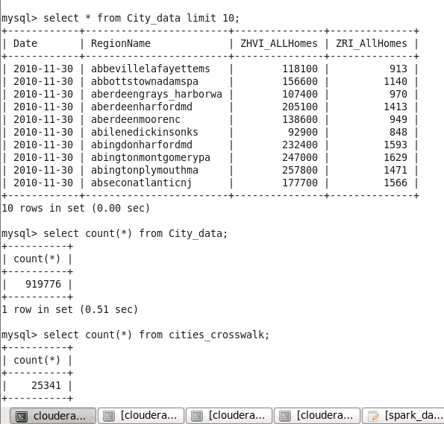
Mysql Query in table

Slide 9
Sqoop Commands
[cloudera@quickstart ~]$ sqoop import \
> --connect jdbc:mysql://localhost/Capstone \
> --username=root --password=cloudera \
> --table City_data\
> --hive-import --hive-table Capstone.City_data
[cloudera@quickstart ~]$ sqoop import \
> --connect jdbc:mysql://localhost/Capstone \
> --username=root --password=cloudera \
> --table cities_crosswalk \
> --hive-import --hive-table Capstone.cities_crosswalk

Slide 10
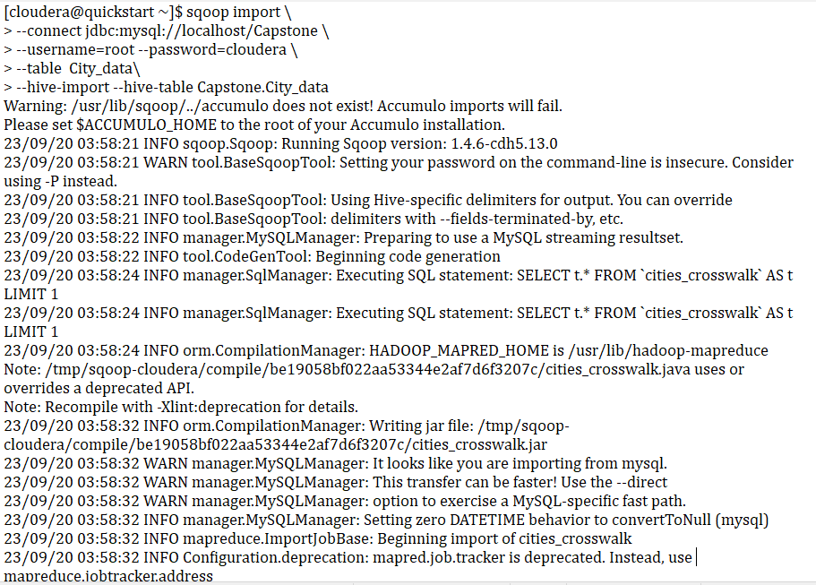
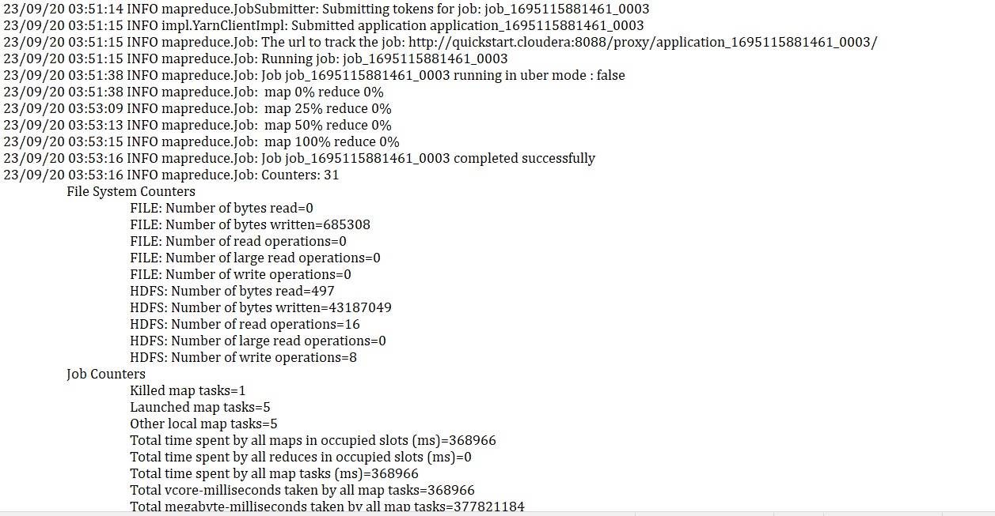
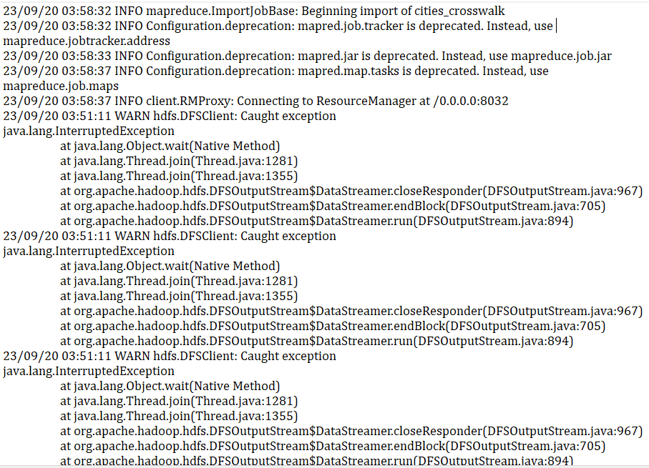
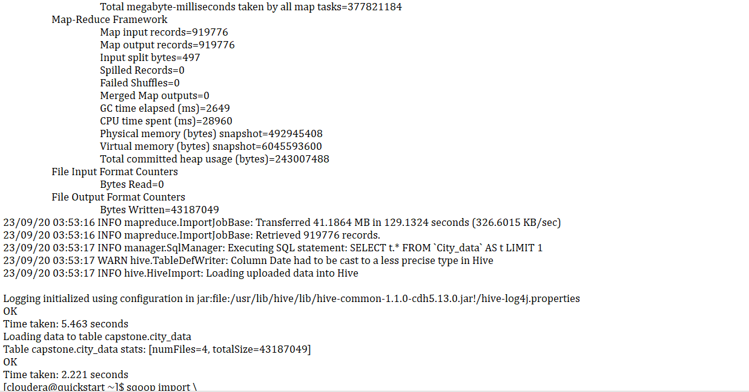
Sqoop commands importing data from MYSQL to HDFS and Hive

Slide 11
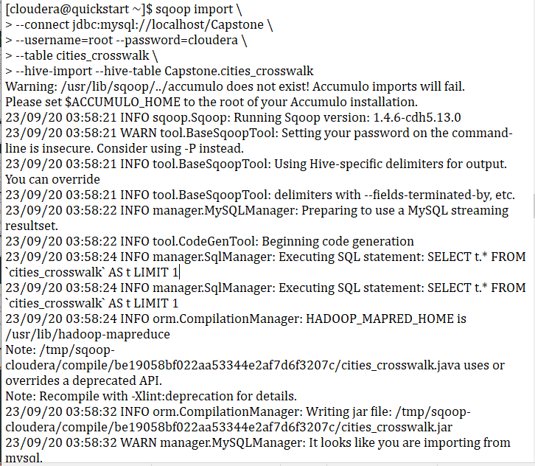
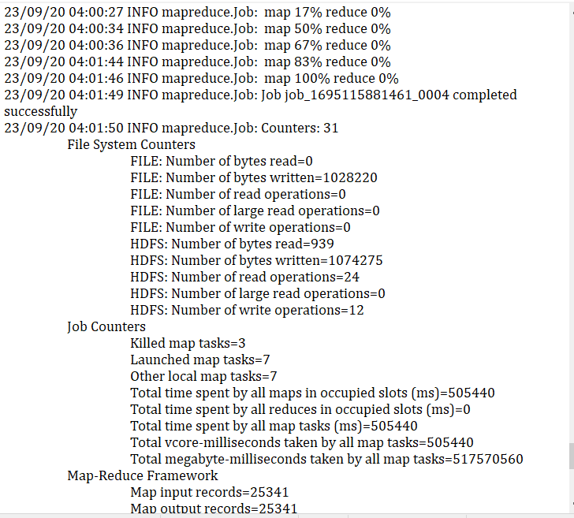
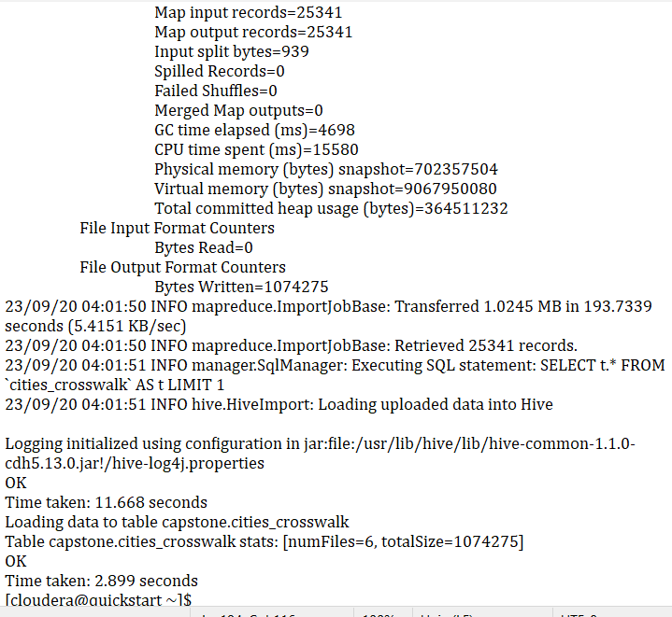
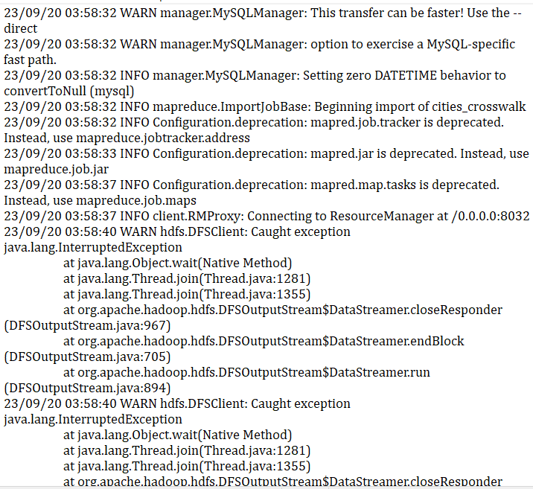
Sqoop commands importing data from MYSQL to HDFS and Hive

Slide 12
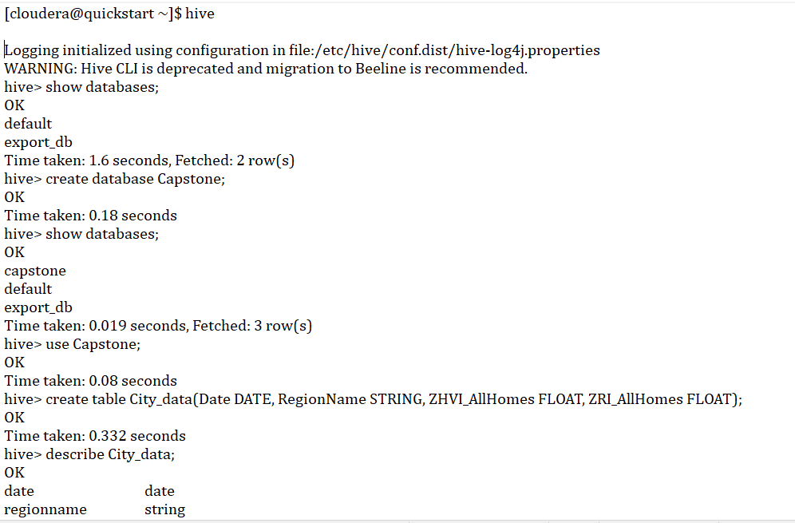
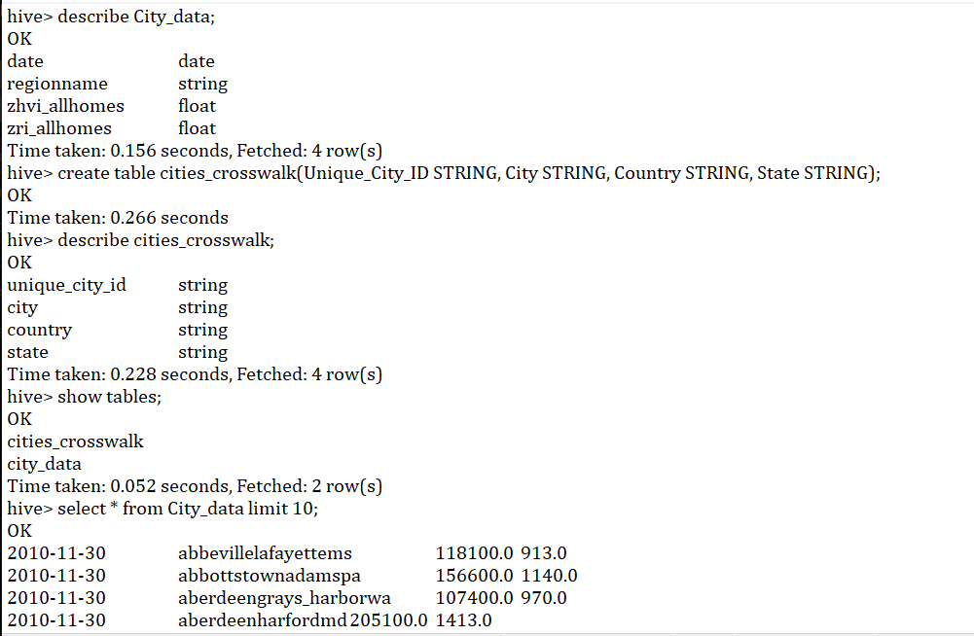
Hive table

Slide 13
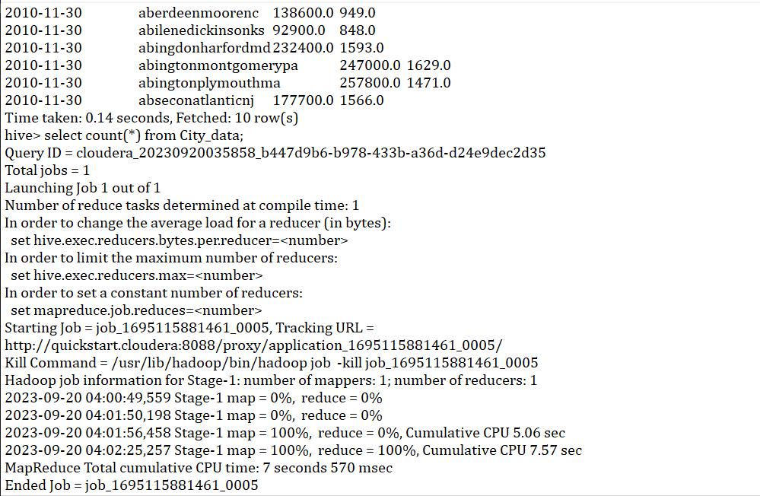
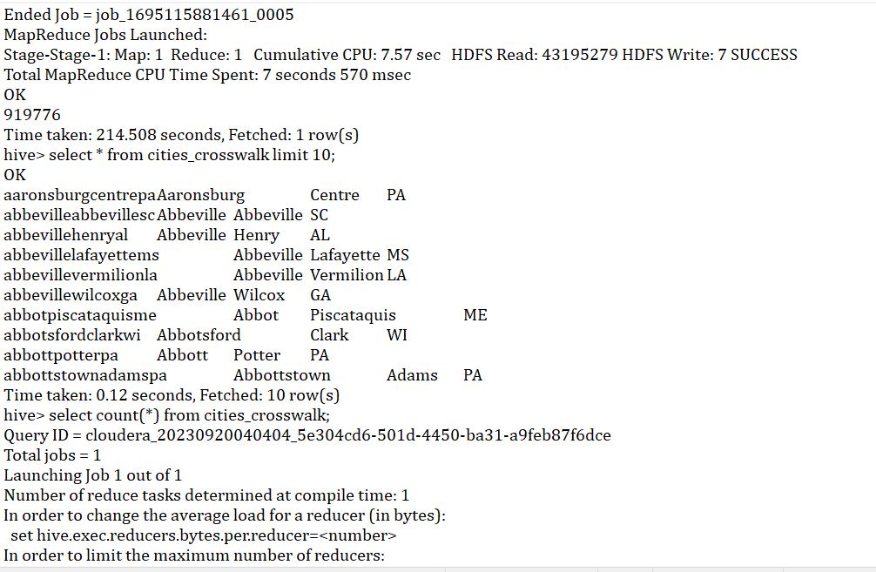
Hive table

Slide 14
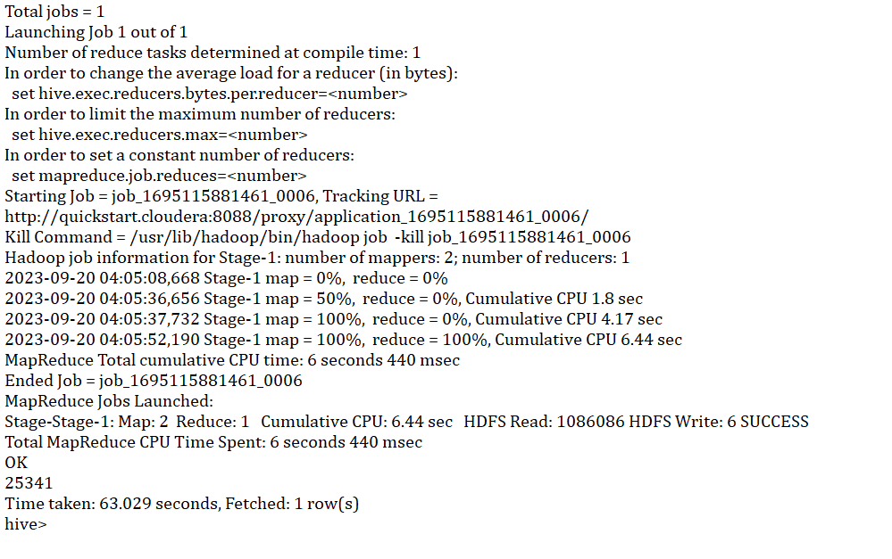
Hive table

Slide 15
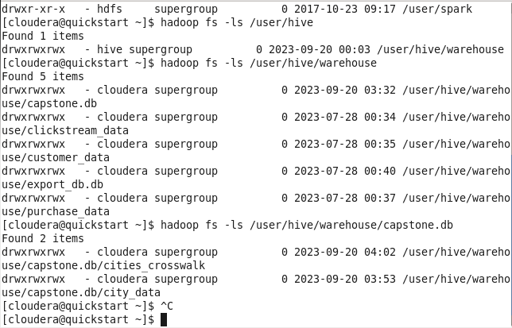
Data in HDFS

Slide 16
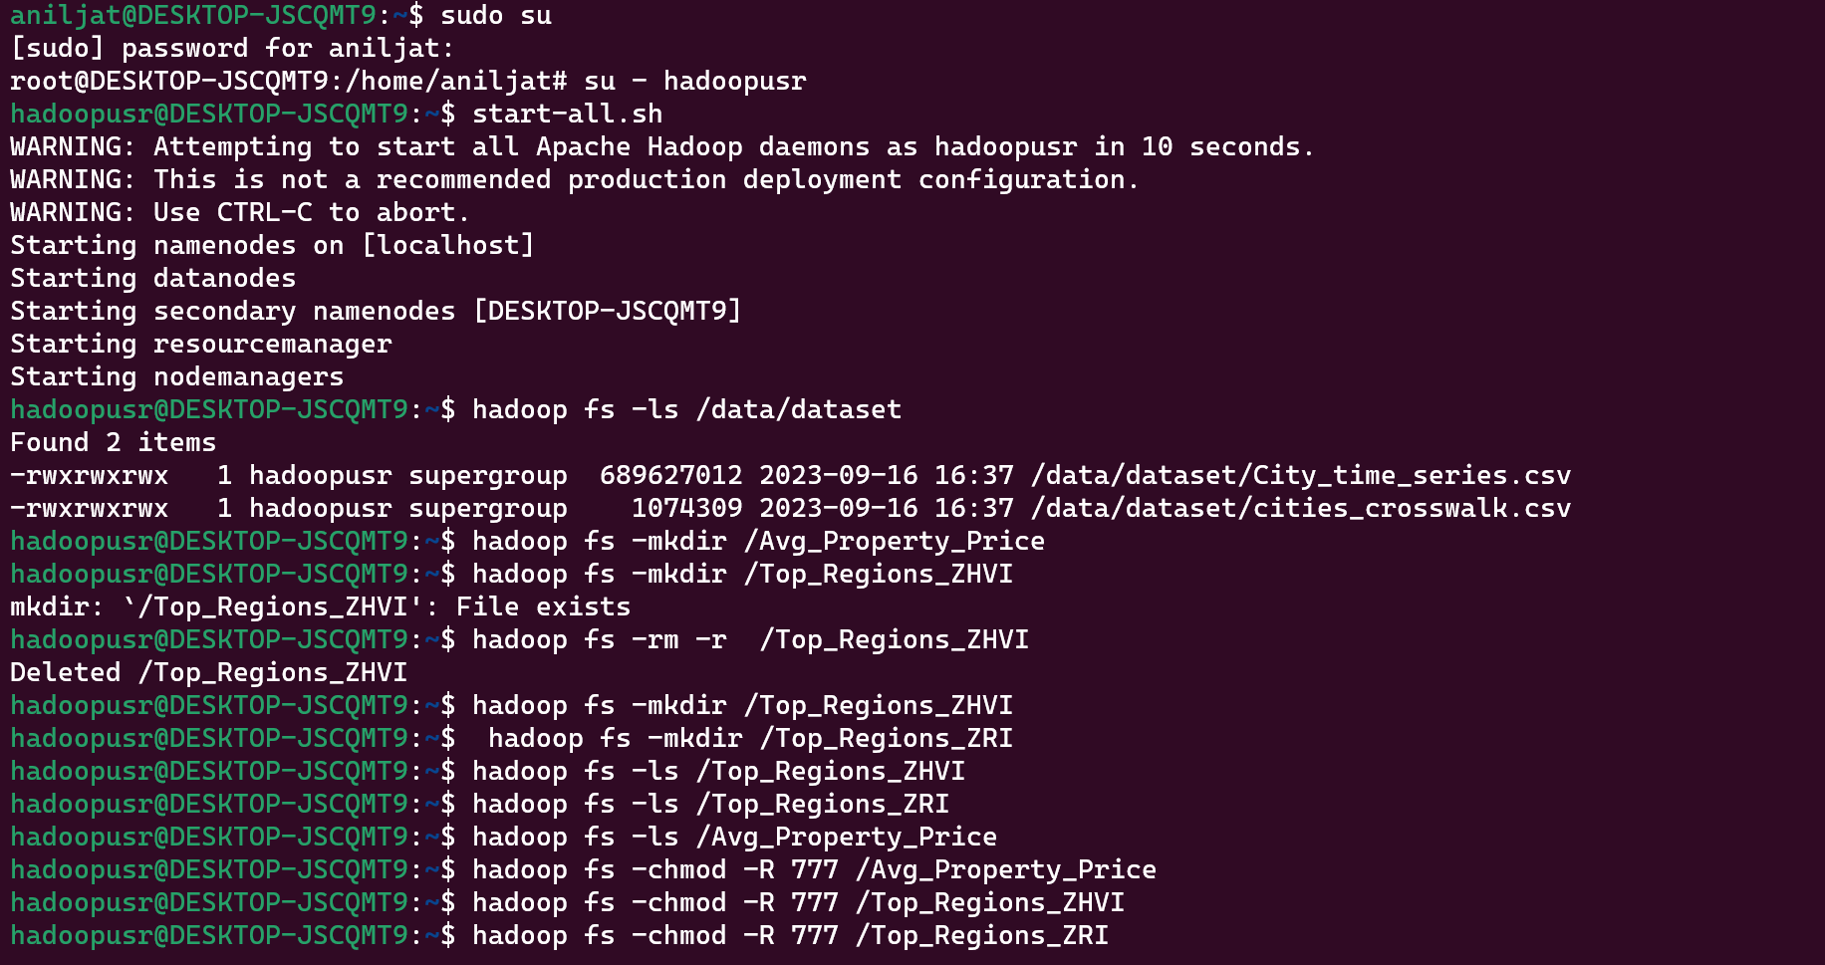
Data in HDFS

Slide 17
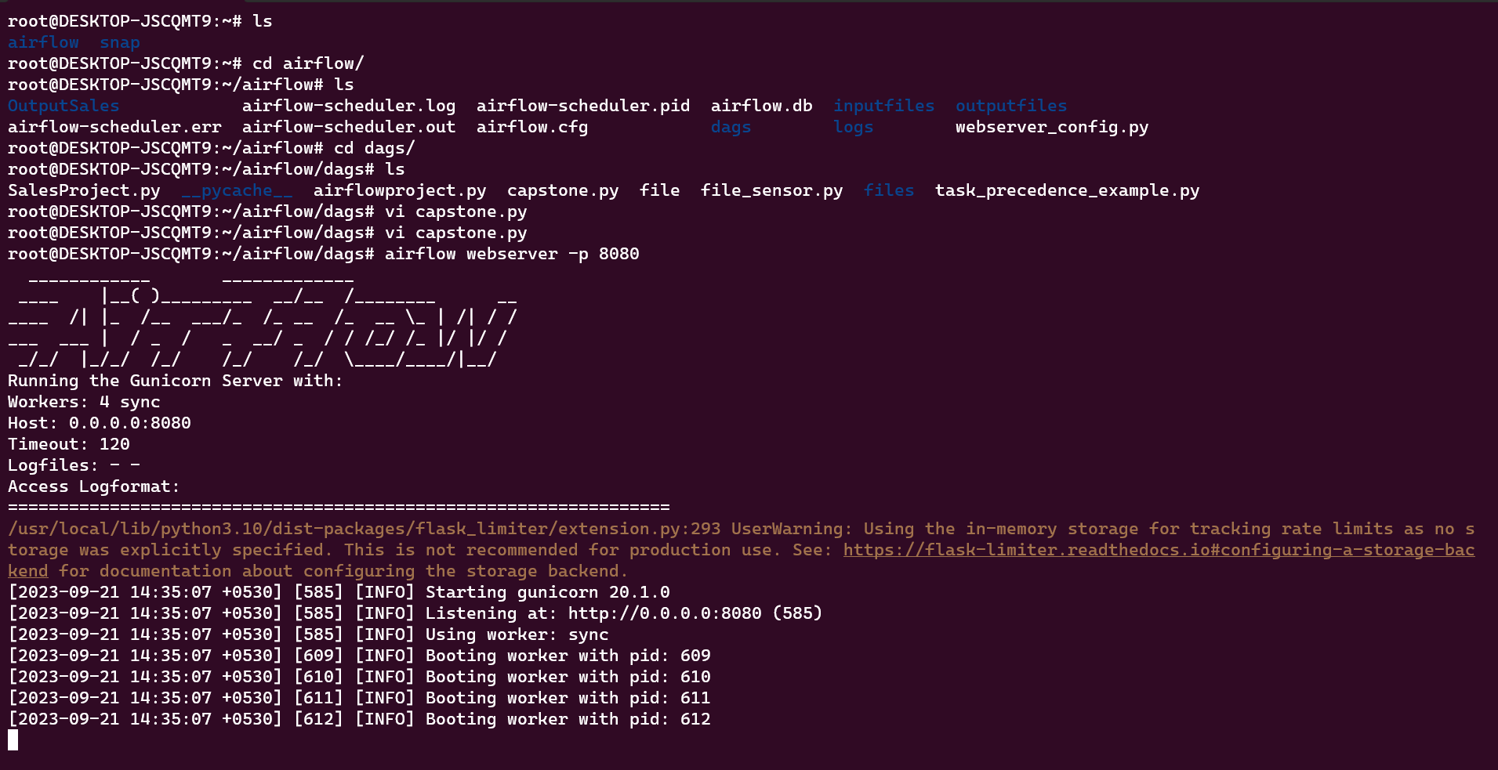
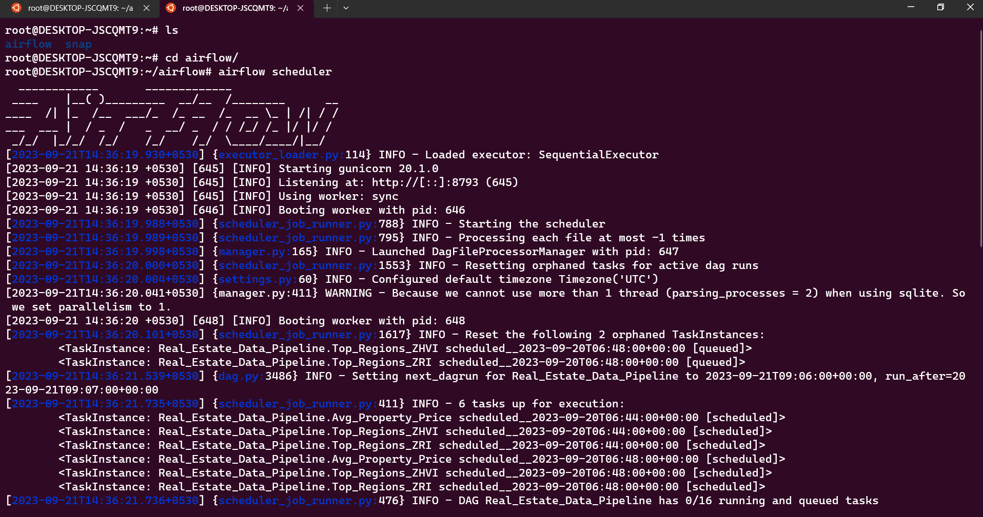
Airflow

Slide 18
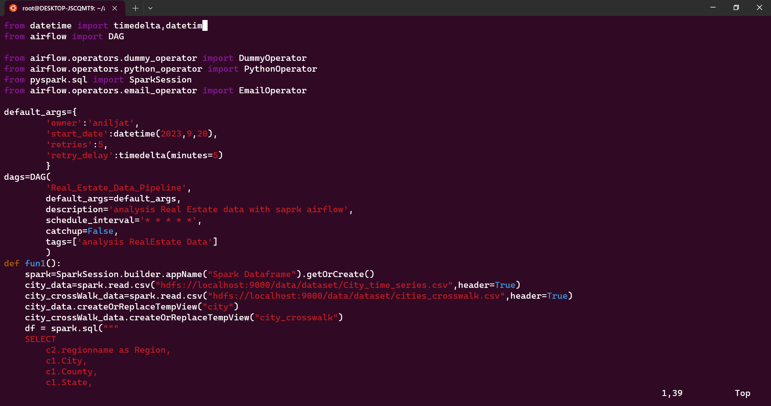
Airflow-PySpark Code

Slide 19
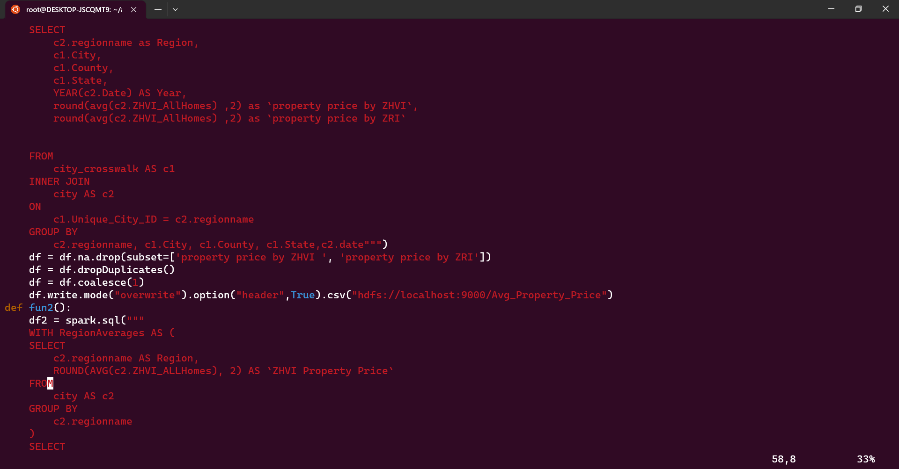
Airflow-PySpark Code

Slide 20
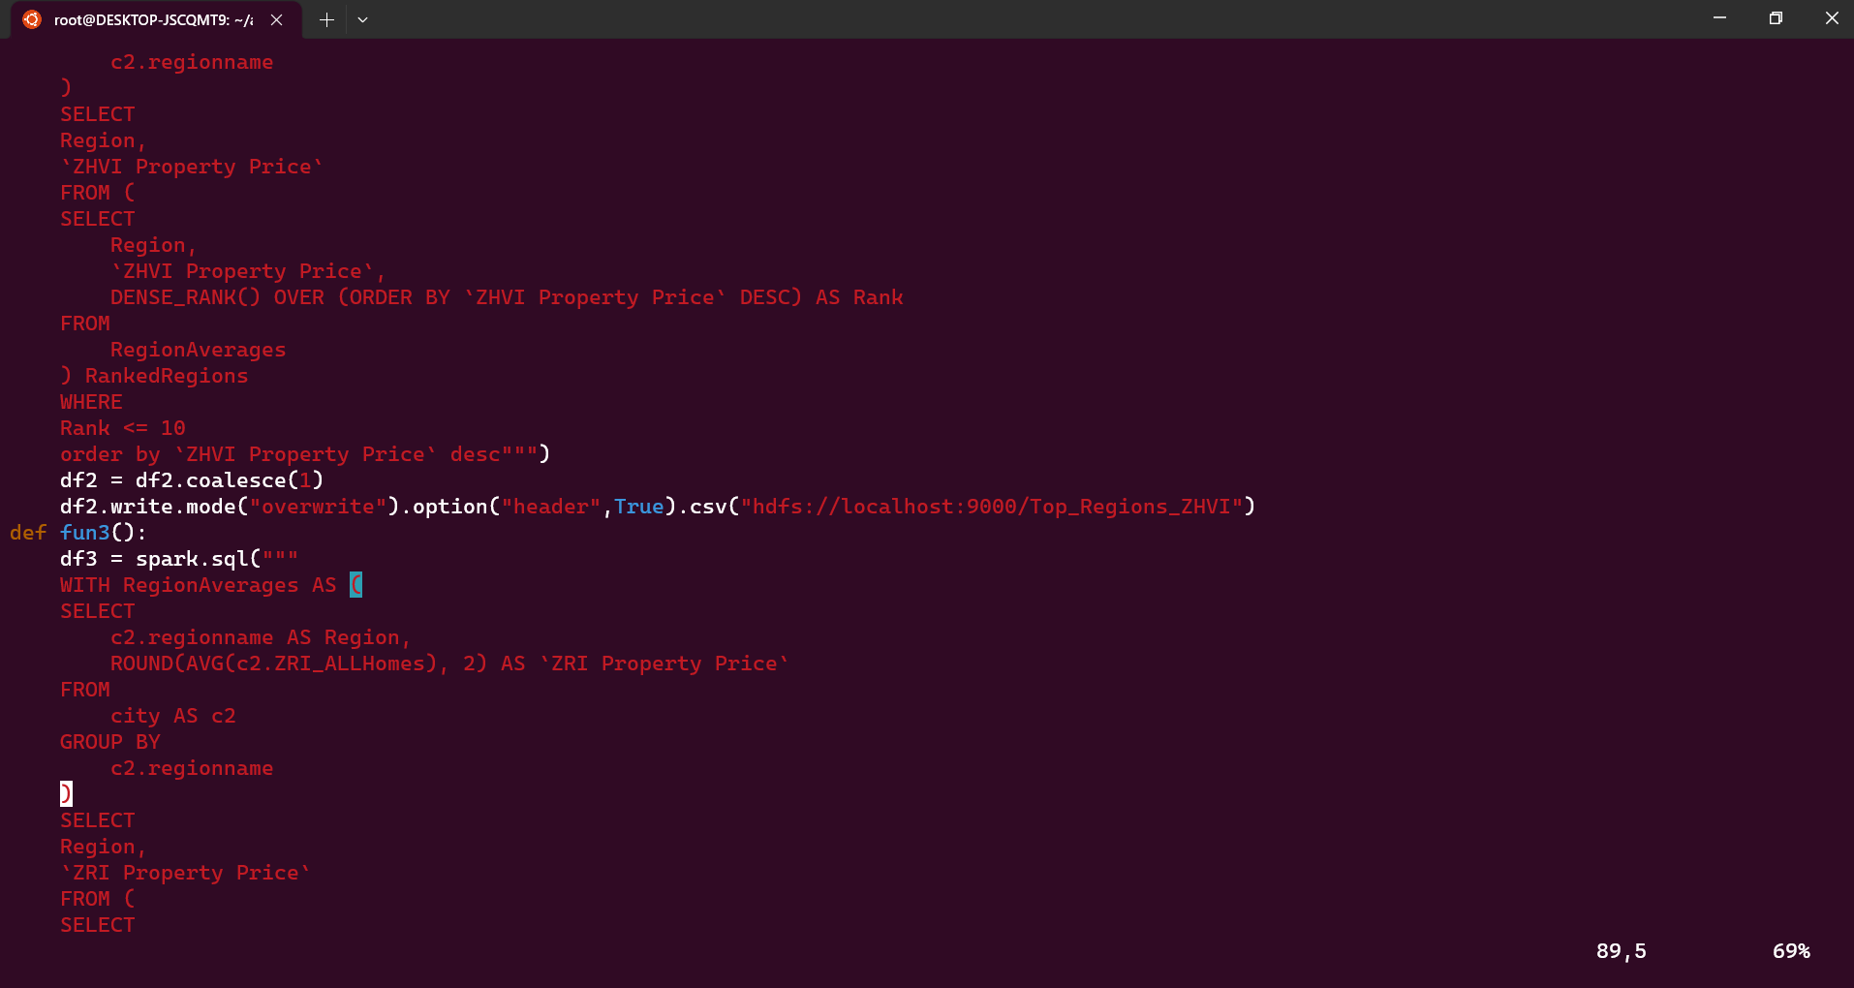
Airflow-PySpark Code

Slide 21
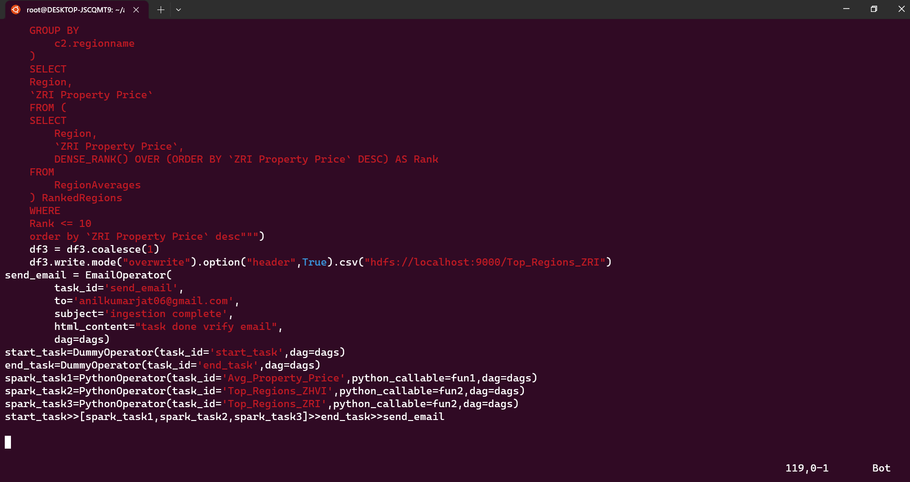
Airflow-PySpark Code

Slide 22
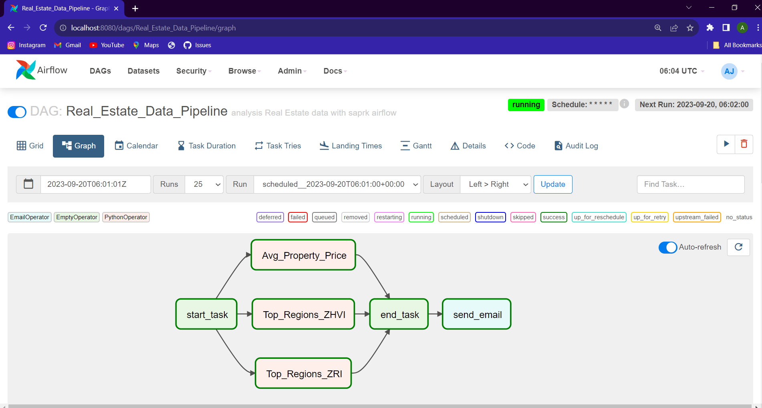
Airflow Graph

Slide 23
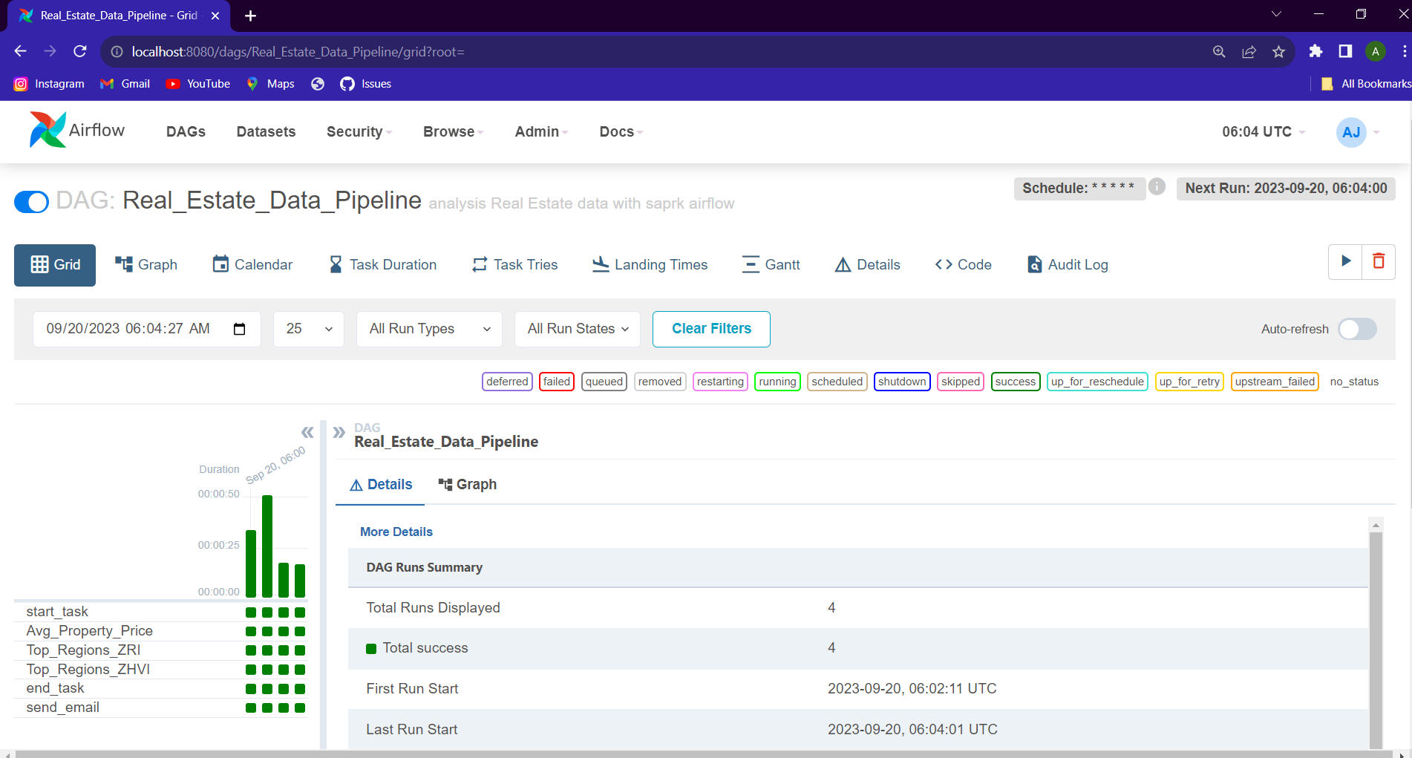
Airflow Grid

Slide 24
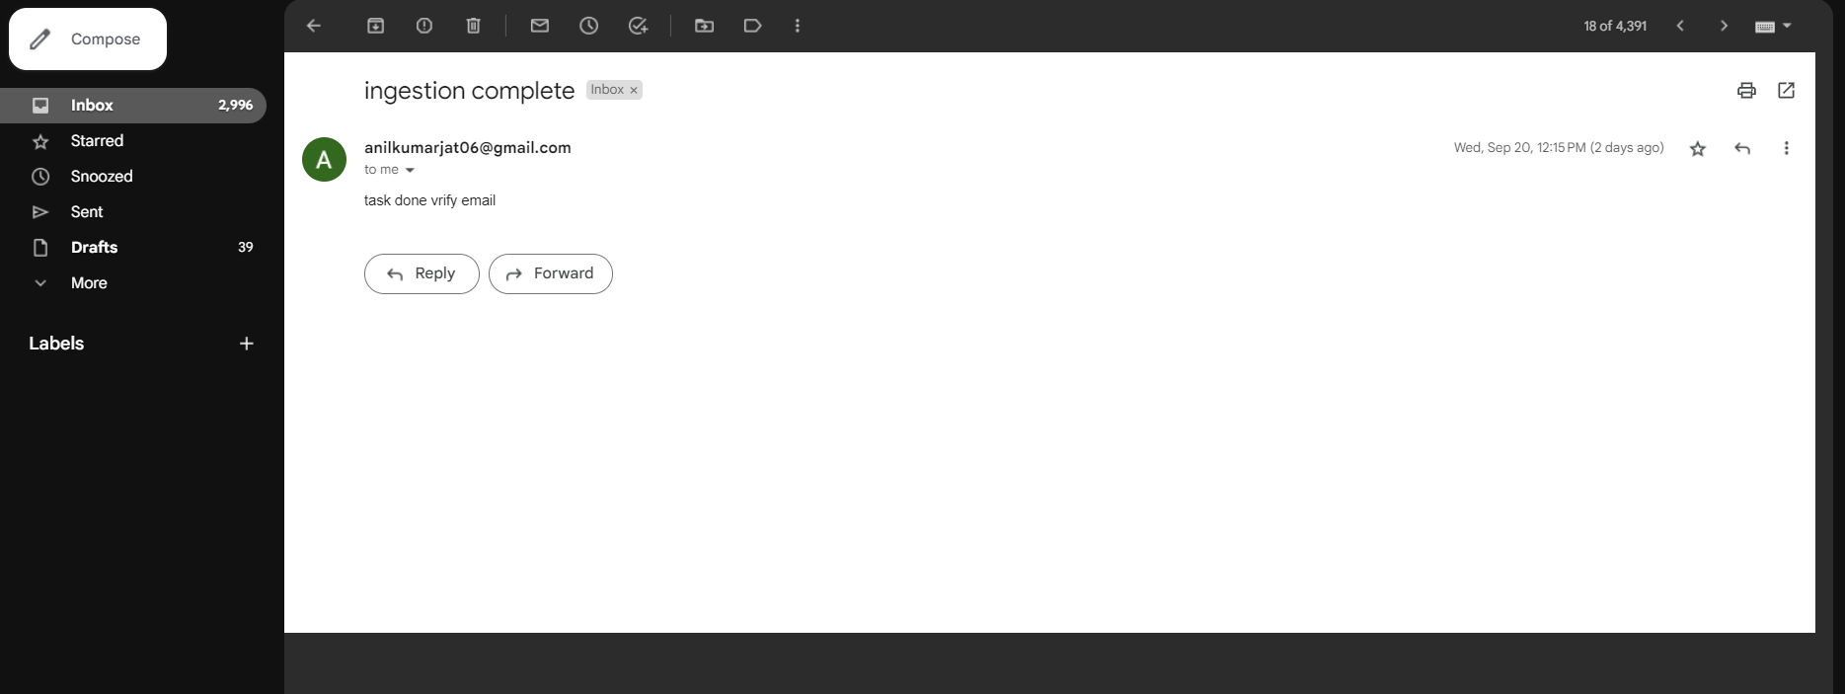
Airflow Verify Email

Slide 25
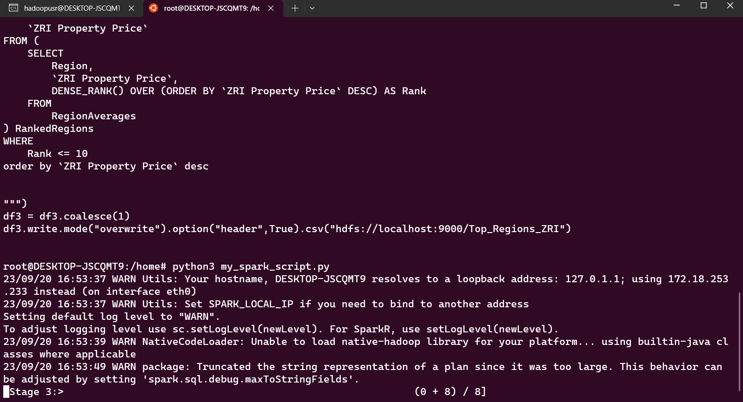
Run PySpark code : Python3 my_spark_script.py

Slide 26
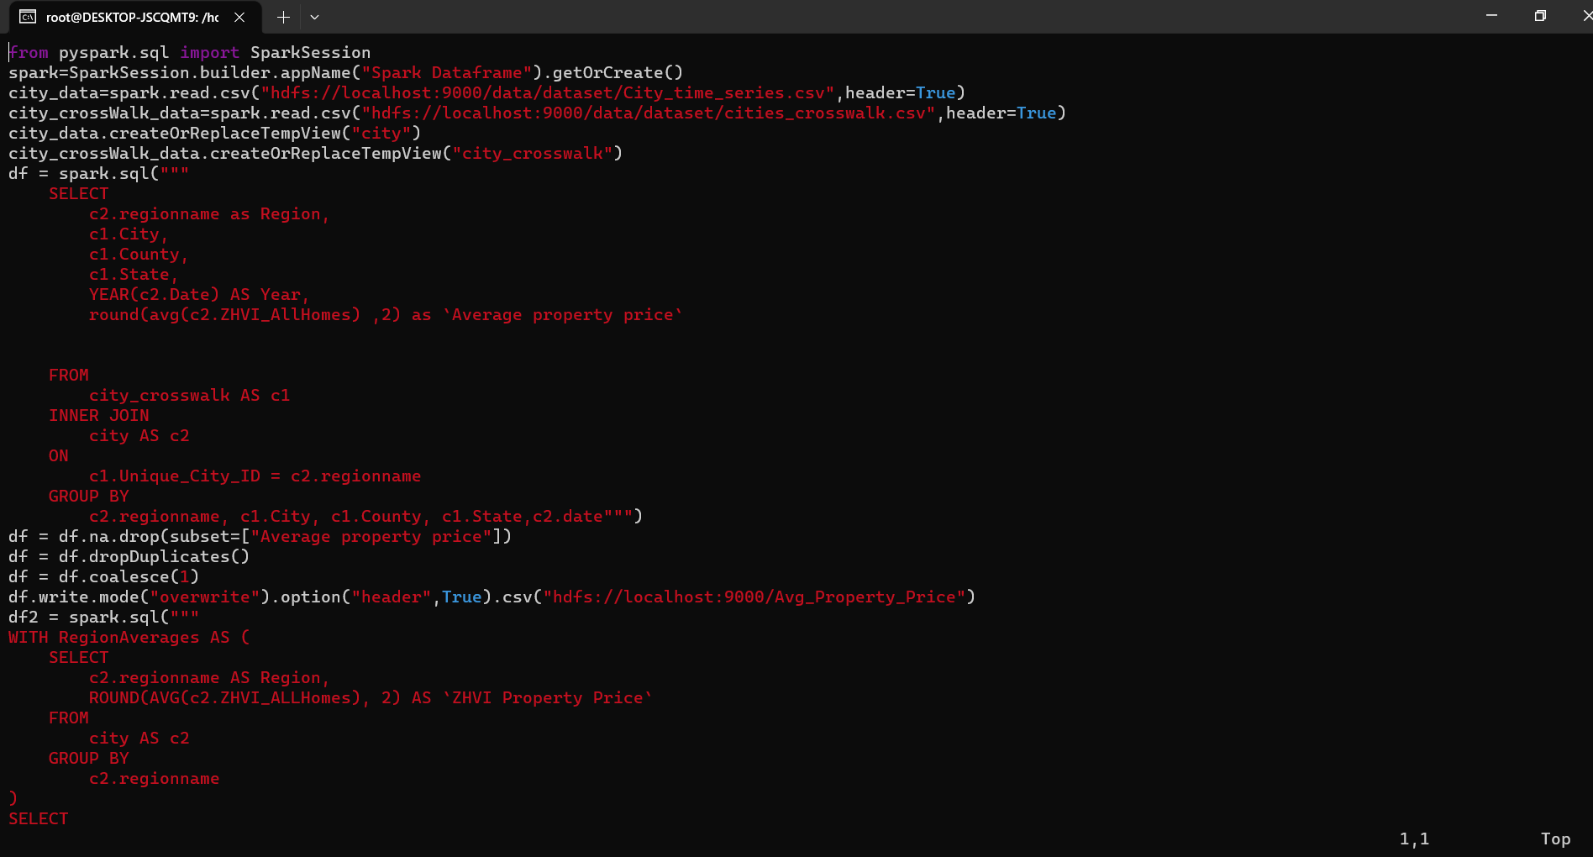
PySpark Code

Slide 27
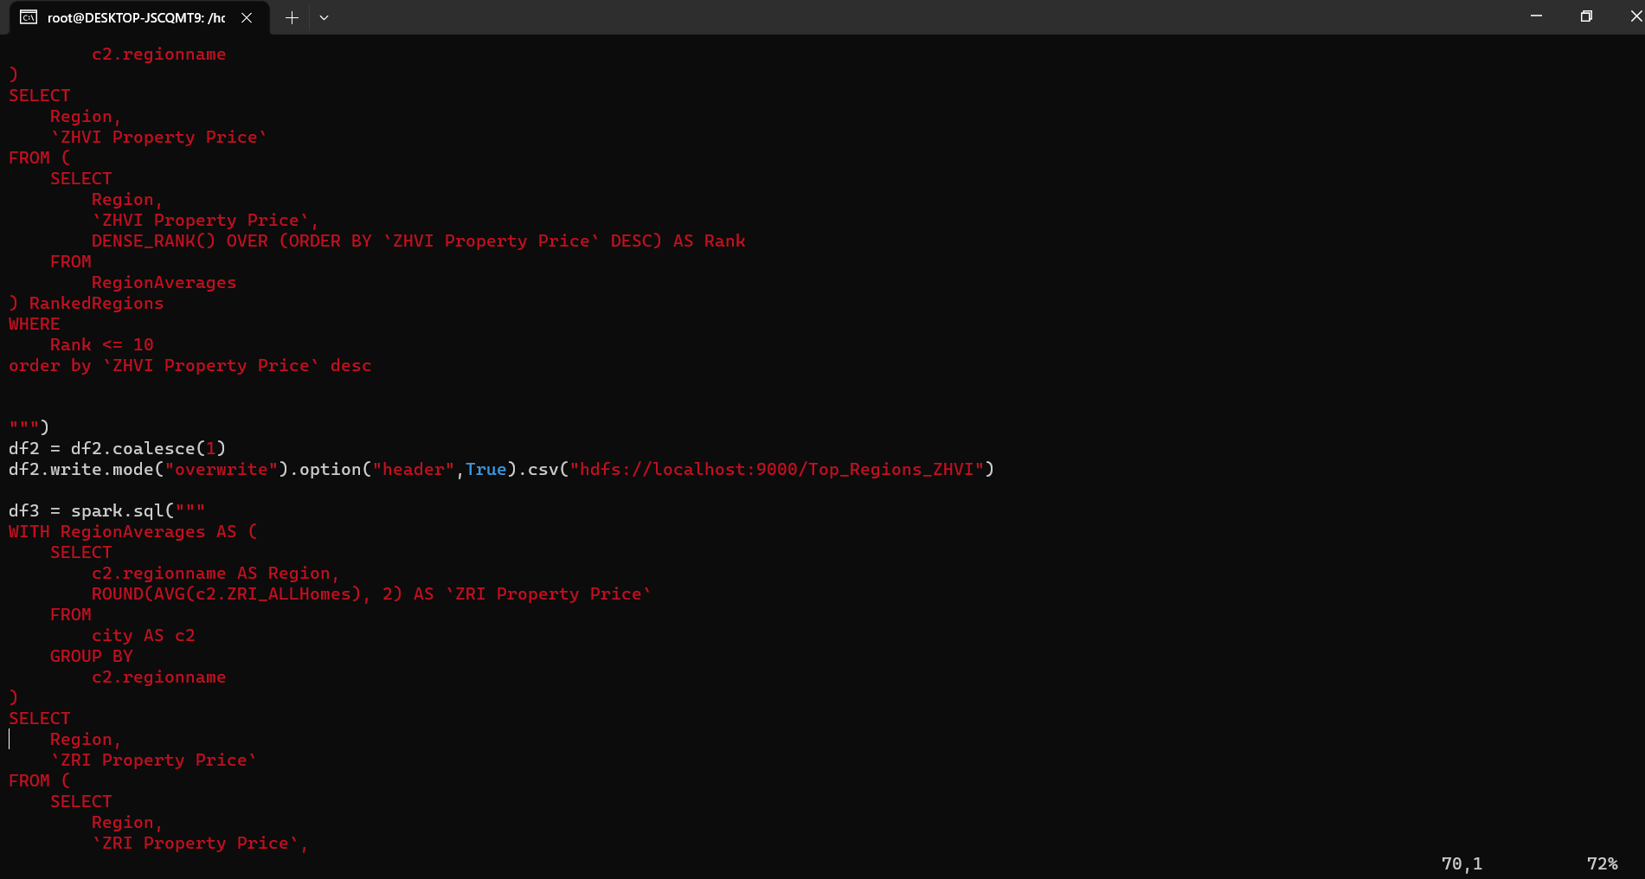
PySpark Code

Slide 28
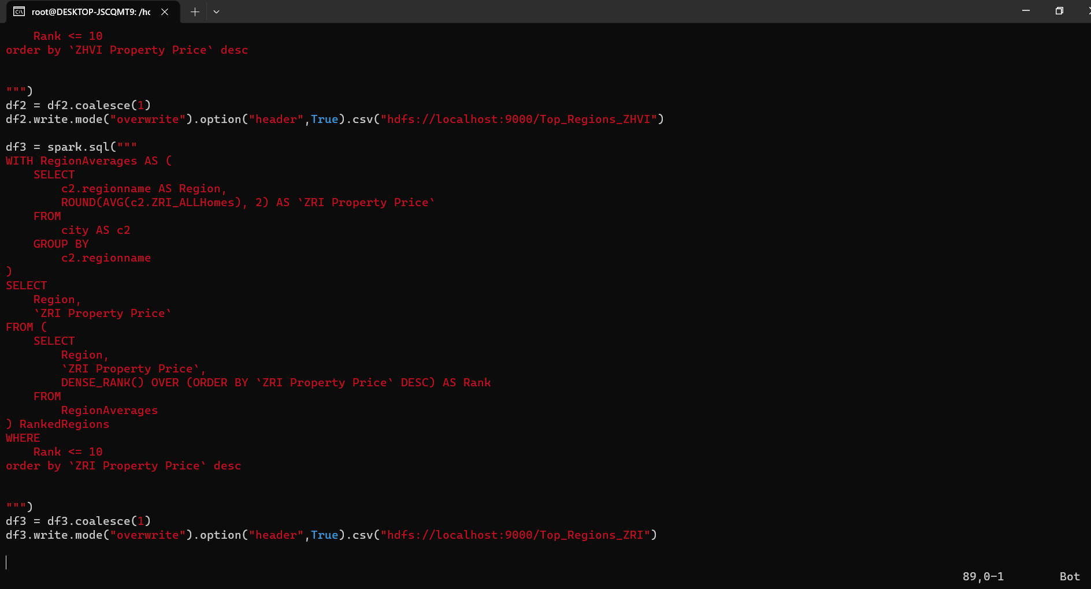
PySpark Code

Slide 29
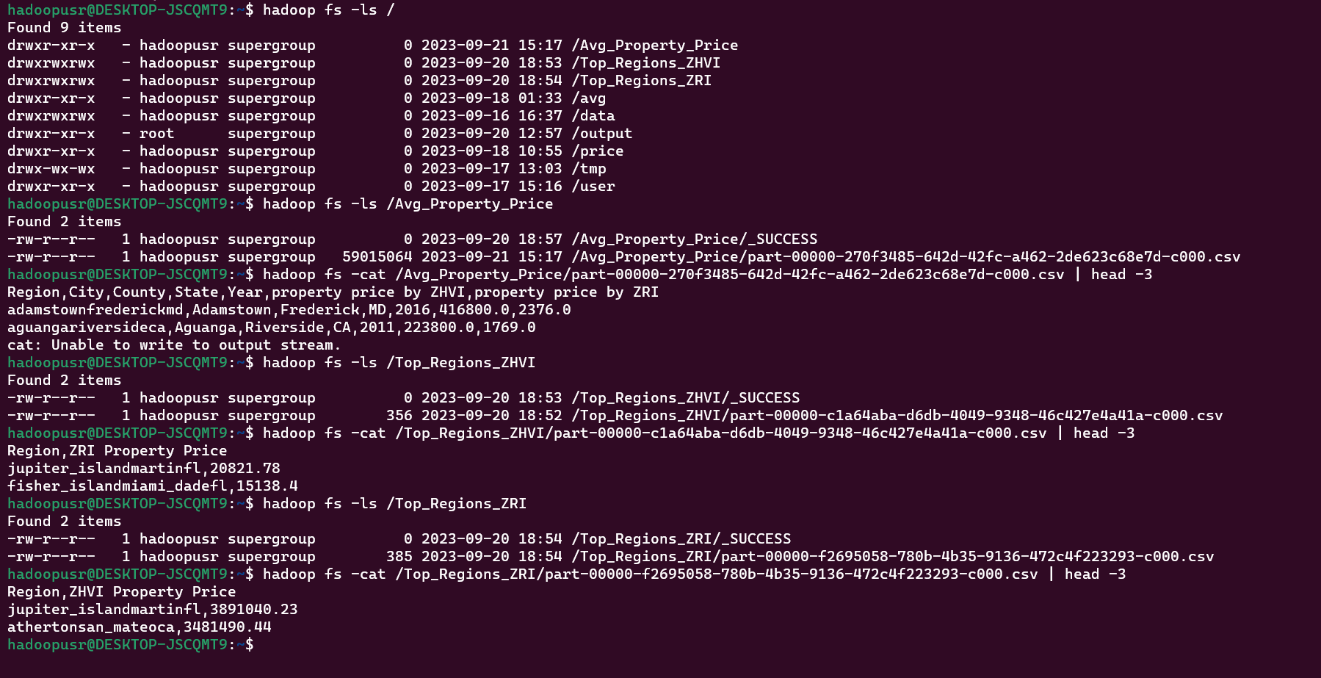
Data After Spark Transformation

Slide 30
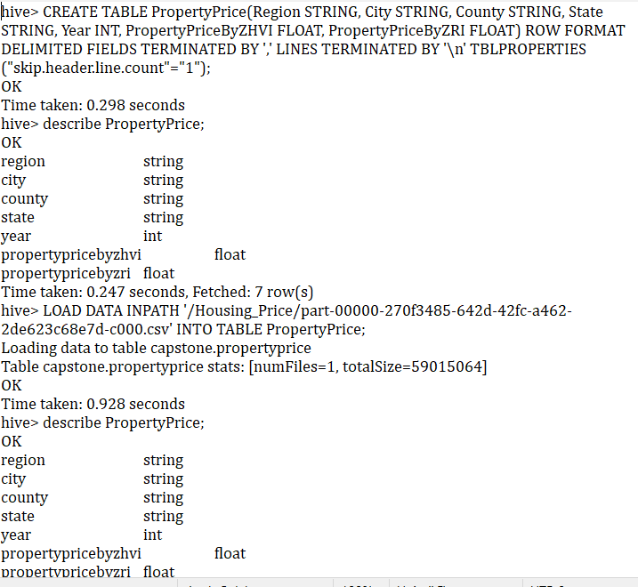
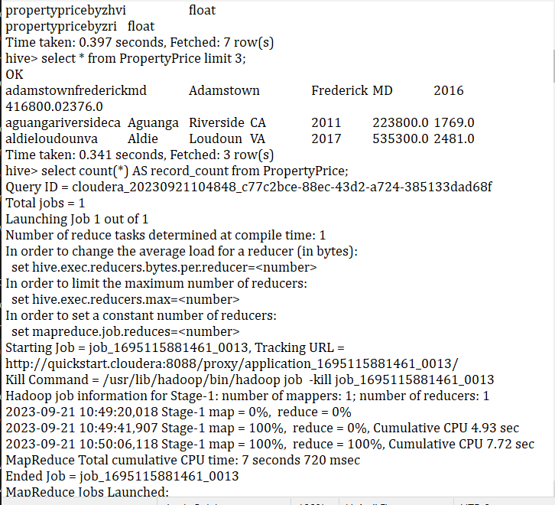
Hive Analysis and Data Quality Check

Slide 31
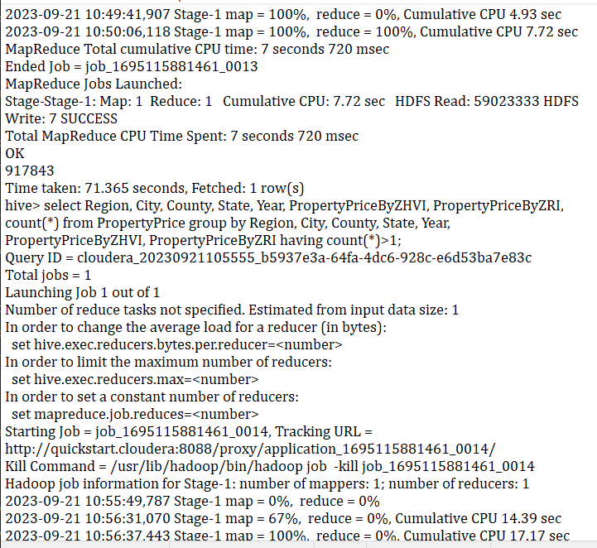
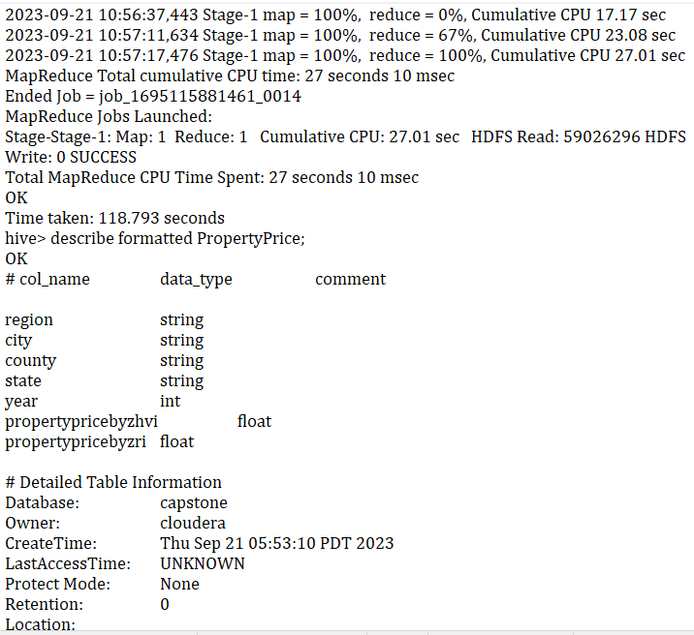
Hive Analysis and Data Quality Check

Slide 32
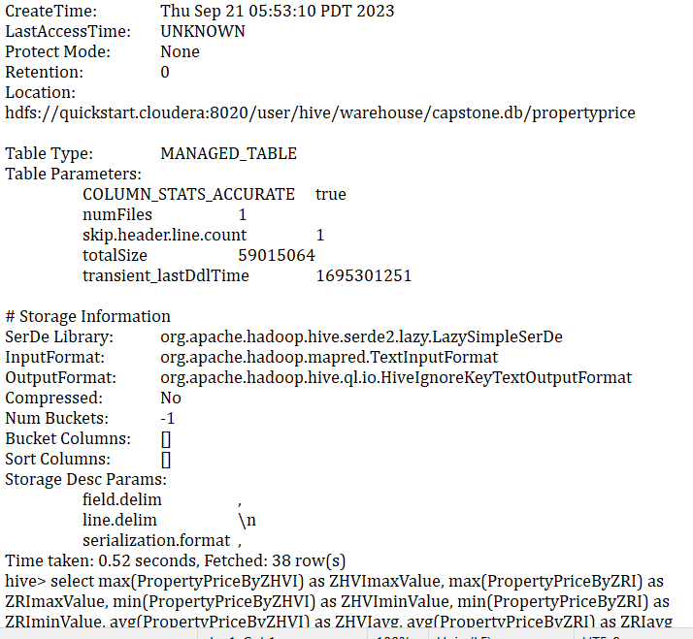
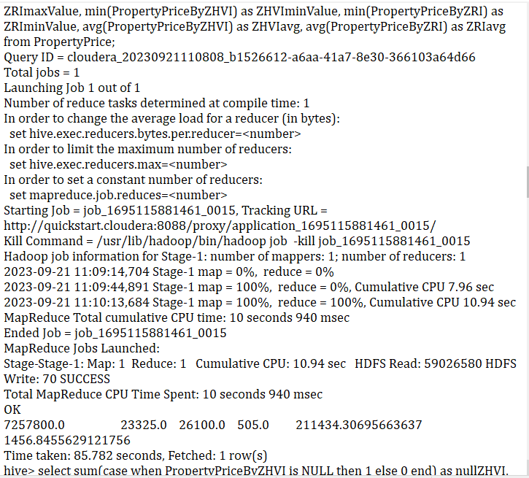
Hive Analysis and Data Quality Check

Slide 33
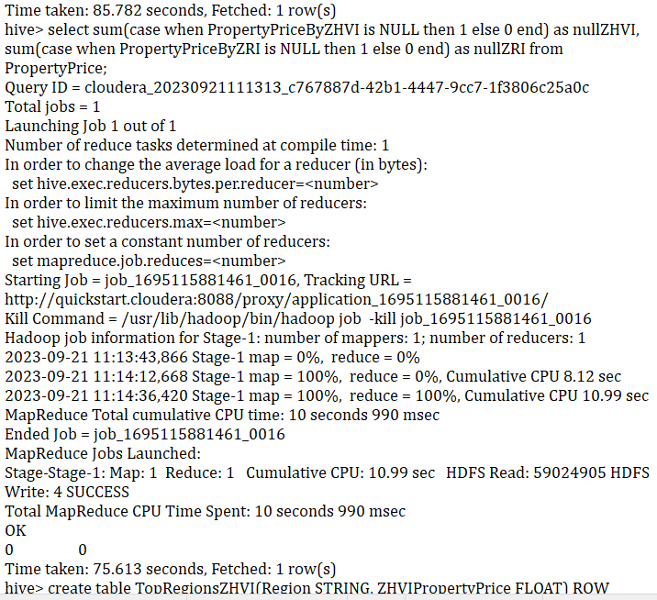
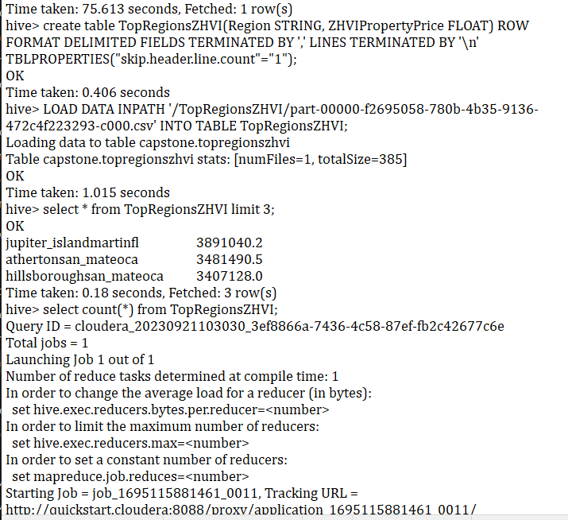
Hive Analysis and Data Quality Check

Slide 34
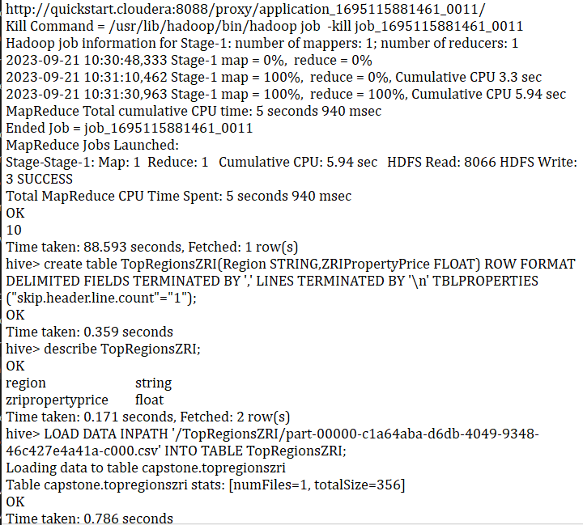
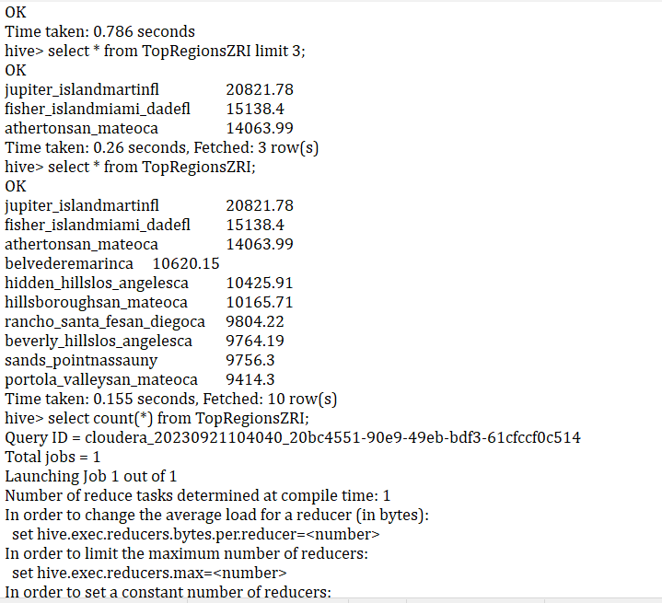
Hive Analysis and Data Quality Check

Slide 35
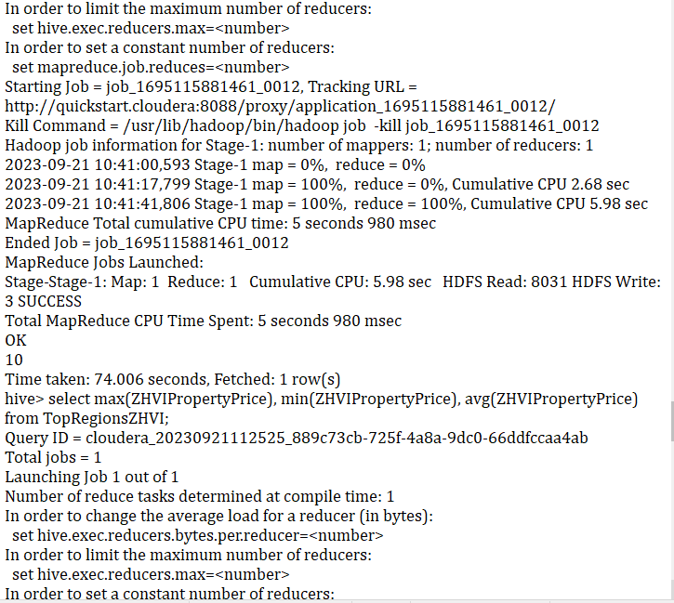
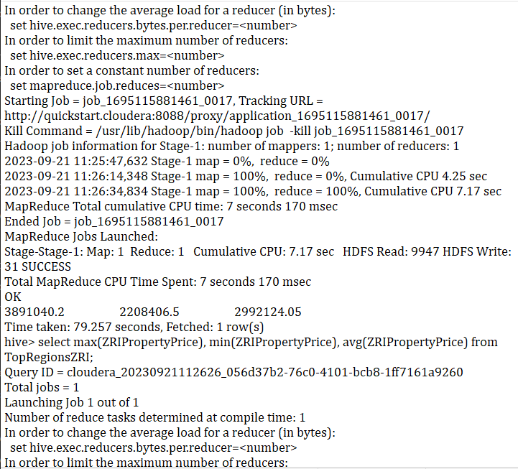
Hive Analysis and Data Quality Check

Slide 36
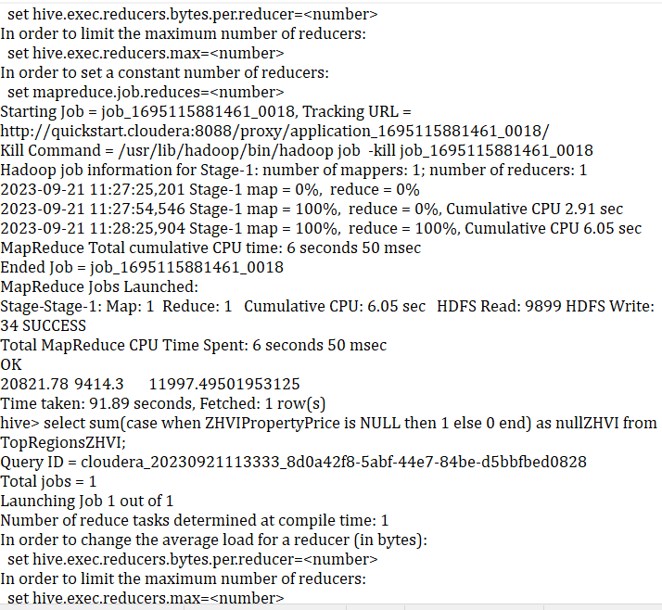
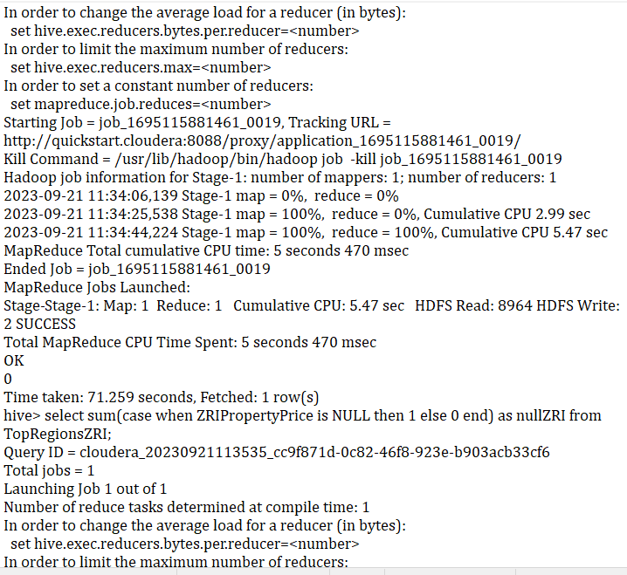
Hive Analysis and Data Quality Check

Slide 37


Hive Analysis and Data Quality Check

Slide 38
Thanks
T

